Slide 1

DDI Cross-Domain Integration (DDI-CDI): Complementing the DDI Product Suite
Arofan Gregory
Chair, DDI-CDI Working Group
3 October 2024

Slide 2
Outline
What DDI-CDI is intended to do
History and emerging requirements for data sharing/integration
What DDI-CDI is and is not
Relationship to DDI Codebook, DDI Lifecycle, DDI CVs, SDTL, and XKOS
Relationship to other standards
Early implementation, tools, and coming projects and documentation
Implementation example: UKDA Product Builder
Implementation examples: ESS Labs and WorldFAIR SPSS/Stata Converter
Summary

Slide 3
What DDI-CDI Is Intended to Do
DDI Cross-Domain Integration extends the metadata coverage of DDI specifications to describe data coming from outside the social, behavioral, and economic (SBE) domain
It allows for the description of data sets to make them “integration ready” in a multi-disciplinary scenario
Focuses on variable and datum-level descriptions
Provides for lossless, automated re-structuring of data
It supports the description of the integration (and any non-SBE lifecycle) process flows
It is not a standard for data collection or management: the focus is on sharing and integration of data
DDI-CDI is designed to work with non-SBE domain standards, and with generic Web standards and technologies, notably RDF

Slide 4
History
The “DDI Moving Forward” project was originally envisioned as producing a model-driven replacement for DDI Lifecycle
Many years were spent developing a very, very large model
Some parts were integrated into DDI Lifecycle (variable cascade, etc.)
DDI-CDI is the first new product to be based on this model (covers the variable cascade, but also the datum-oriented focus)
During its development, it became apparent that we did not need a replacement for DDI Lifecycle!
What we needed was something new: a way of describing non-rectangular data for use in cross-domain scenarios and with new forms of data
Aligned with DDI Codebook and DDI Lifecycle
Designed to support different requirements (FAIR, etc.)

Slide 5
Emerging Requirements
Describe data from other domains
Might be structured differently (sensor/event data, multi-dimensional data, big data, etc.)
Metadata might be encoded using non-XML technology in a different domain standard/model (esp. RDF and Web standards)
Might be the output of a different data lifecycle
Terminology/semantics would be different
DDI-CDI had to be domain-agnostic
Focus on the data, not on the study
Direct support for non-DDI standards/models (i.e., SKOS, DCAT, etc.)
Needed a generic process flow description
Data had to be placed in its own context
Other domains produce data in unfamiliar ways – this information is needed for accurate integration
Requirements aligned exactly with those of “cross-domain FAIR” data sharing

Slide 6
What DDI-CDI Is
A model for describing variables, including concepts and representations
Provides a full model of the variable cascade
Provides variable descriptions independent of their use in a specific structure
Links to externally defined semantics (CV, ontology, classification, etc.)
A model describing how variables are used in structures
Wide/unit-record/rectangular
Long/tall (sensor or event data, registers)
Multi-dimensional data (superset of SDMX, covers indicators)
Key-value (big data, No-SQL, etc.)
A generic model for describing process flows
A model for describing datums and their relationships to each other, to variables, etc.
DDI-CDI provides a superset model intended to be implemented in “profiles” (subsets)

Slide 7
DDI-CDI Model
Predictable,
automatable
DDI-CDI
Description
DDI-CDI
Description
Domain Metadata Standards/ Models
- Variables
- Structure
- Roles (Dimensions, Measures)
- Physical arrangement
[TRANSFORMATION]
- Variables
- Structure
- Roles (Identifiers, Attributes. Measures)
- Physical arrangement
Predictable,
automatable
[TRANSFORMATION]
Dimensional Data Set:
Age x Year x Region x Education Level x Sex
Wide Data Set: Dimensions viewed as
Variables (properties)

Slide 8
AGE
YEAR
AGE
YEAR
SEX
REGION
EDUC LEVEL
MEASURE
AGE
YEAR
SEX
REGION
EDUC LEVEL
MEASURE
SEX
REGION
AGE
YEAR
SEX
REGION
EDUC LEVEL
MEASURE
EDUC LEVEL
AGE
YEAR
SEX
REGION
EDUC LEVEL
MEASURE
MEASURE
The target format is wide, with the dimensions treated as variables (properties):
at least one must be a place where integration can be performed with
another data set (typically time and geography). Other variables may be
combined into compound identifiers, or may be treated as additional
descriptors or measures, depending on what they are. The roles of variables
Change according to the structures – the meanings/values do not.
Aggregate values would be repeated to align with micro-data records as
needed to provide the “complete” records for analysis.
Recoding/semantic transformations are handled separately as appropriate
to the structural re-arrangement.
VARIABLES

Slide 9
What DDI-CDI Is (continued)
A UML model expressed in Canonical XMI
Syntax representation in XML (XML Schema)
Syntax representation in RDF (OWL/RDF-S vocabulary, expressed as Turtle and JSON-LD)
A specification designed to be directly combined with other specifications
DDI Codebook/Lifecycle
SKOS/XKOS
DCAT
Process descriptions (SDTL, VTL, PROV, programming code, etc.)
Any other specification (esp. in RDF)

Slide 10
What DDI-CDI is Not
A replacement for DDI Codebook or DDI Lifecycle for data production, management, or archiving
An XML representation of human-readable documentation at the study level
A monolithic model for describing the data lifecycle
Does not provide information to manage longitudinal studies
Does not present the “data lifecycle” in a specific form

Slide 11
DDI-CDI and DDI Specifications
Metadata can be programmatically derived from DDI Codebook and Lifecycle
Process descriptions can reference DDI Codebook/Lifecycle metadata (datasets, variables)
Instrument and Study descriptions in DDI Codebook/DDI Lifecycle can be referenced
Can use DDI CVs (esp. in SKOS) to define semantics
Can describe processing with SDTL/SDTH
Can represent codelists/categories/classifications with SKOS/XKOS when represented in RDF
Instead of DDI-CDI classes

Slide 12
DDI-CDI with other Domain Standards
DDI-CDI is designed to be populated not only from DDI Codebook and Lifecycle metadata, but from similar metadata in any domain specification
Domain-agnostic terminology
Generic description of many different data structures
Generic process flow description
External semantic definitions for concepts
Leverages RDF design to allow combination with metadata in other common Web (or domain) vocabularies
Acts as a “common language” for moving between domain specifications
Used in CDIF for this purpose
Example: SDG Indicators disaggregations: SDMX-to-DDI-CDI-to-Schema.org in Google Data Commons

Slide 13
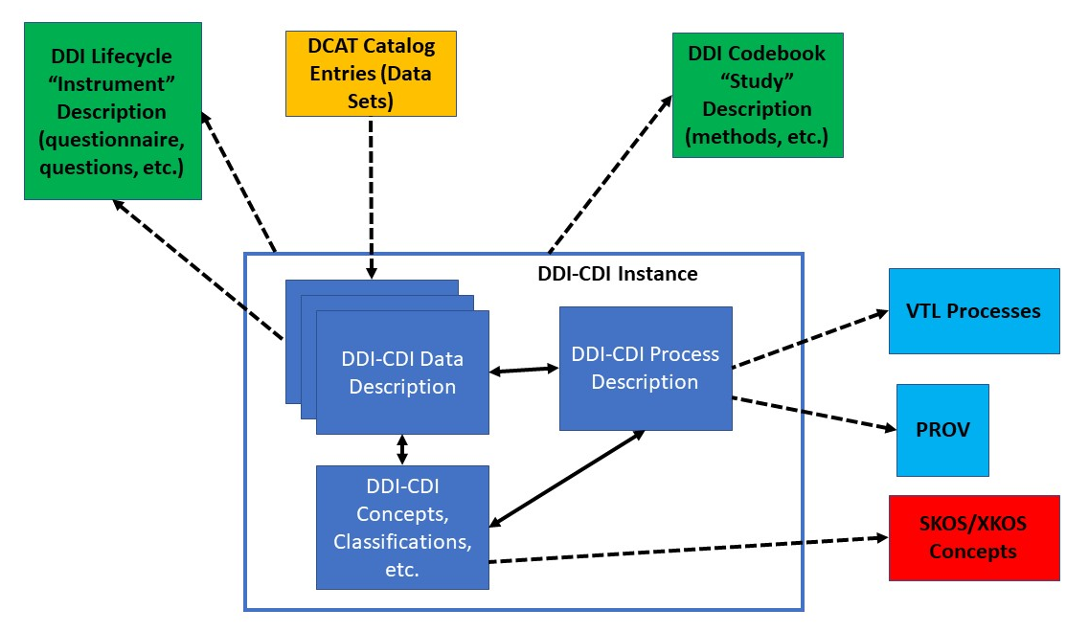
DDI-CDI with Other Standards - Example

Slide 14
Early Implementations
UKDA Product Builder (variables and structures)
EOSC Future “ESS Labs” integration of European Social Survey with Climate and Environmental Data (process)
US Bureau of Labor/BLS (indicators, variable cascade )
UN Statistical Division SDG Indicator disaggregations (multi-dimensional data and variables)
WorldFAIR Cross-Domain Interoperability Framework (CDIF)
Minimum data description profile (approx. 30 classes for long, wide, multi-dimensional)

Slide 15
Tools
Field-level documentation tool
Subsets of selected elements
Browseable documentation of selected classes
Postman-funded “High Value Data Services” (in testing)
Wrappers municipal data in Socrata in DDI-CDI and DDI Codebook
Python libraries for working with DDI-CDI metadata
Dataverse implementation (design stages)
WorldFAIR (Sikt) Stata/SPSS-to-DDI-CDI Converter (to the Datum level)
“Nectar Publisher” CSV/Excel-to-DDI-CDI converter (under development)
Work in the DDI Developer’s Group
SDMX-to-DDI-CDI Converter
Prototyped by UNSD for CDIF
ESS Labs Process Browser (prototype)

Slide 16
Upcoming Projects
EOSC CLIMATE ADAPT
Horizon-funded
Integration of environmental and social data
EU OSCAR X-Ray Absorption Spectroscopy (XAS) project
Example of hard-science implementation for exchanging measuring device data on chemical spectrum with other domains
Other WorldFAIR+
Second round of World FAIR
Many CDIF implementations for climate data, life sciences, hard science physical data, medical and clinical data, others
Others (?)

Slide 17
Existing & Upcoming Documentation
High-level documentation (part of 1.0 spec)
Field-Level Documentation (part of 1.0 spec)
Integrated with syntax representations
Subsetting for community profiles
https://ddi-cdi.github.io/ddi-cdi_v1.0-rc3/field-level-documentation/
Business case document (nearly complete)
DDI-CDI with other Standards (nearly complete)
DDI-CDI Reference Profile for RDF (50% complete)
Creating DDI-CDI Implementation Guides (50% complete)
Standing up a Git repository for DDI-CDI Resources (profiles, application code, etc.)

Slide 18
Examples
UKDA Product Builder
Sikt: ESS Labs and WorldFAIR SPSS/Stata converter

Slide 19
Summary
DDI-CDI is designed to accommodate new types of data and data from other domains – domain-agnostic
Does not replace DDI Codebook or DDI Lifecycle!
Works with many other DDI products (DDI Codebook, DDI Lifecycle, DDI CVs, XKOS, SDTL)
Works with RDF and generic Web standards, and also domain standards
Already tested in early implementations
Very popular in the cross-domain FAIR space (CDIF)
Many tools under development
Good documentation and support now in development

Slide 20

DDI - CDI: Integrating Data for Better Science!

